Slide 1

Arduino (Continued)
Engineering Hands-on

Slide 2
Microcontroller
Integrated circuit with a microprocessor that controls I/O.
Arduinos, can be used for various applications and projects.
Samples projects are available from www.arduino.cc

Slide 3
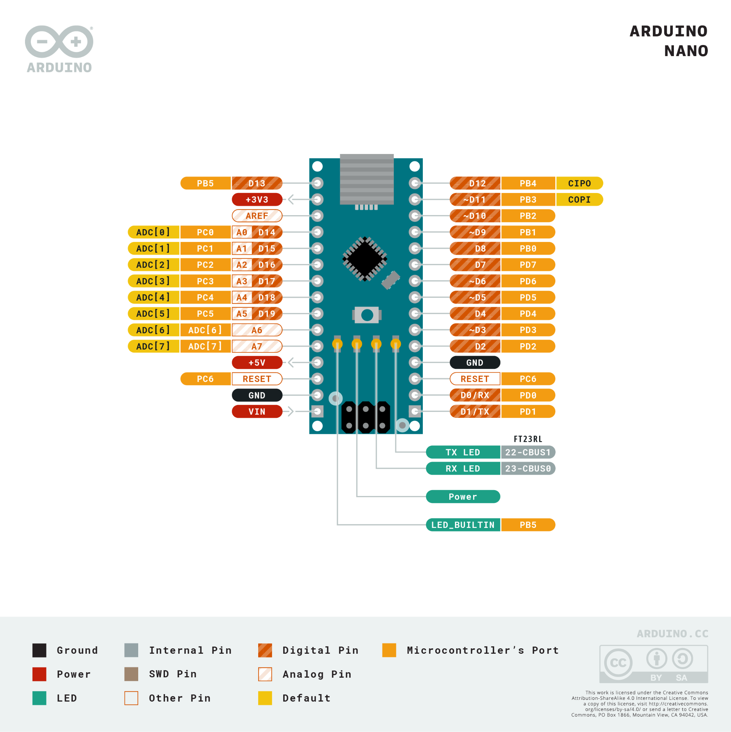
Arduino Nano – Pinout

Slide 4
Arduino IDE
Download from Arduino®
https://docs.arduino.cc/software/ide-v1
You can download IDE v2 as well if you prefer, but we are going to be using the classic v1 as it is more reliable.
Built-in Examples can help you to use the Arduino programming library to achieve tasks.

Slide 5
Digital Pins
Input/Output digital signals.
pinMode(PIN, MODE);
digitalRead(PIN);
digitalWrite(PIN, VAL);

Slide 6
PWM pins (3,5,6,9,10,11)
analogWrite(PIN, VAL);
analogRead(PIN, VAL);

Slide 7
Analogue input (A0-A7)
analogRead(PIN);

Slide 8
Arduino Library + C Programming Language
Arduino Library Reference: https://www.arduino.cc/reference/en/

Slide 9
Sample Program: LED Blinker
void setup() {
// put your setup code here, to run once:
pinMode(9, OUTPUT);
}
void loop() {
// put your main code here, to run repeatedly:
digitalWrite(9, HIGH);
delay(2000);
digitalWrite(9,LOW);
delay(2000);
}

Slide 10
LED Blinker Flow
void loop() {
// put your main code here, to run repeatedly:
for (int i = 3; i < 12; i++) {
digitalWrite(i, HIGH);
delay(500);
}
for (int i = 12; i >= 3; i--) {
digitalWrite(i, LOW);
delay(500);
}
}
void setup() {
// put your setup code here, to run once:
for (int i = 3; i < 12; i++) {
pinMode(i, OUTPUT);
}
}

Slide 11
LED intensity PWM
void loop() {
// put your main code here, to run repeatedly:
for (int i = 0; i < 6; i++) {
for (int j = 0; j < 256; j++) {
analogWrite(pins[i], j);
delay(300);
}
}
delay(1000);
for (int i = 6; i >= 0; i--) {
for (int j = 255; j >= 0; j--) {
analogWrite(pins[i], j);
delay(300);
}
}
delay(1000);
}
int pins[] = {3,5,6,9,10,11};
void setup() {
for (int i = 0; i < 6; i++) {
pinMode(pins[i], OUTPUT);
}
}

Slide 12
Buzzers and using the tone library
#define BUZZER_PIN 8
int idx;
int FrequencyArr[5] = {150, 350, 550, 750, 950};
void setup() {
pinMode(BUZZER_PIN, OUTPUT);
idx = 0;
}
void loop() {
tone(BUZZER_PIN, FrequencyArr[idx++]);
// tone generates a square wave based on the frequency.
delay(500);
if (idx == 5) {
idx = 0;
}
}

Slide 13
Potentiometer (0-1023) and AnalogRead & RGB LED
Hook the potentiometer (middle pin) to the analogue pins (A0-A5)
The RGB LEDs are controlled by PWM, therefore connect them to the PWM digital pins. Each colour is between the range of 0 to 255.

Slide 14
LCD Screen
// include the library code:
#include <LiquidCrystal.h>
// initialize the library by associating any needed LCD interface pin
// with the arduino pin number it is connected to
const int rs = 12, en = 11, d4 = 5, d5 = 4, d6 = 3, d7 = 2;
LiquidCrystal lcd(rs, en, d4, d5, d6, d7);
void setup() {
// set up the LCD's number of columns and rows:
lcd.begin(16, 2);
// Print a message to the LCD.
lcd.print("hello, world!");
}
void loop() {
// set the cursor to column 0, line 1
// (note: line 1 is the second row, since counting begins with 0):
lcd.setCursor(0, 1);
// print the number of seconds since reset:
lcd.print(millis() / 1000);
}

Slide 15
Ultrasonic Distance Sensor
https://howtomechatronics.com/tutorials/arduino/ultrasonic-sensor-hc-sr04/

